Slide 1
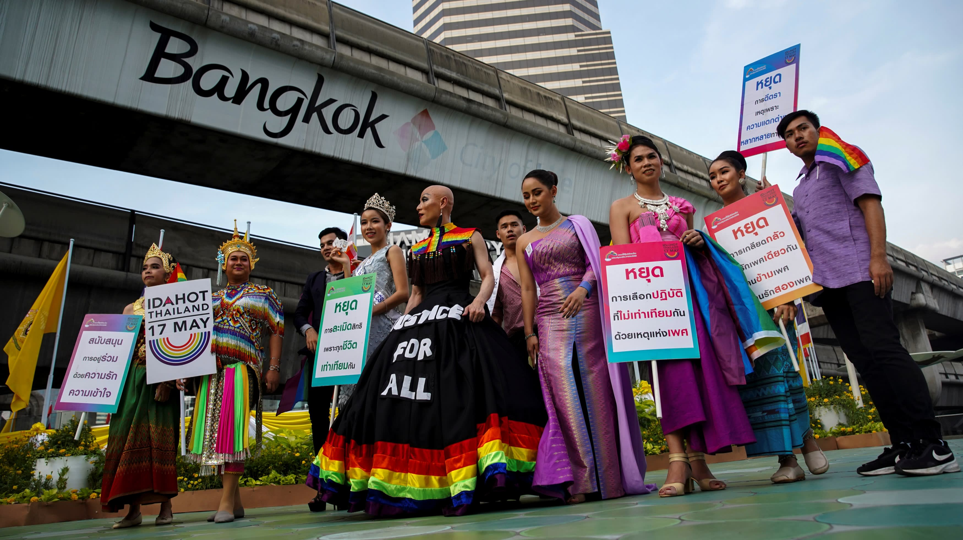

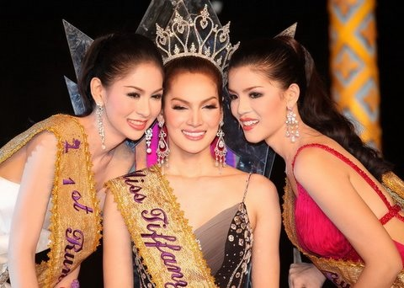
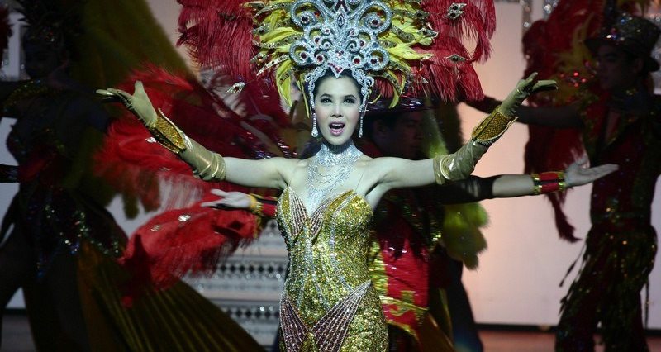

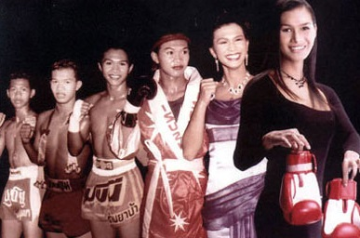
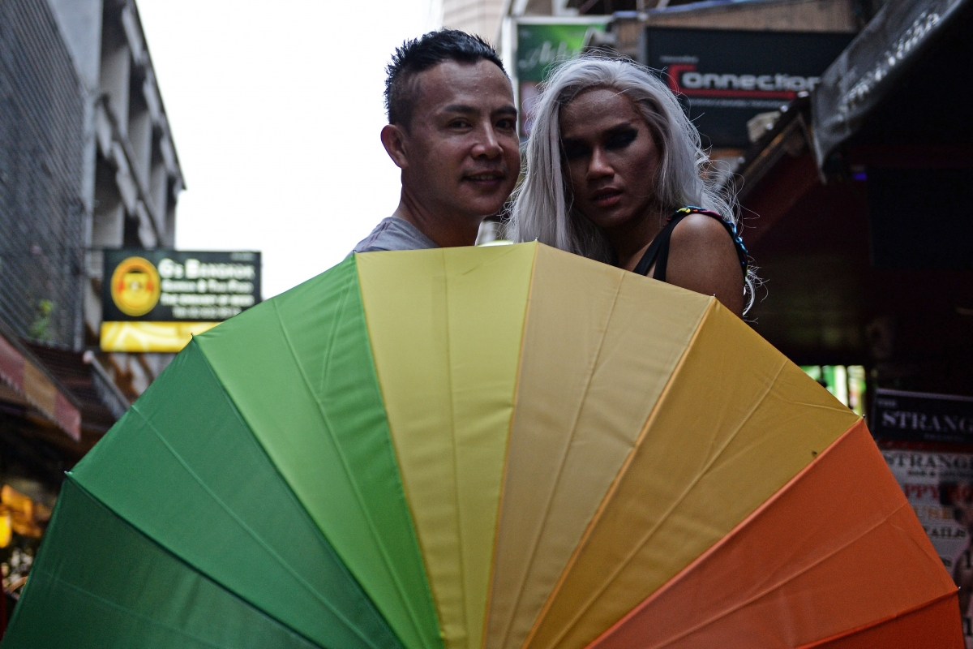
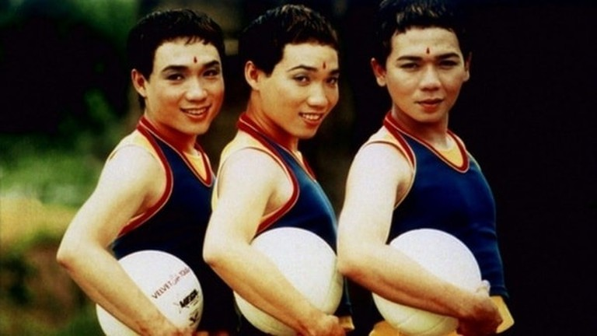
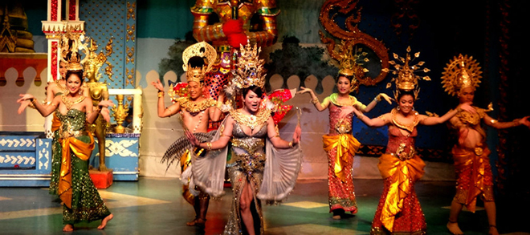
LGBTQ Culture in Thailand
Nalongsone Danddank
Introduction
Thailand is The most popular tour around the world to visit, and the one popular reason that attracting people's inquisitively is Ladyboys or Kathoey, the transgender women.
The Iron Ladies
One of the successful gay films in Thailand and international. It depicts the various homosexual factions in Thai culture, particularly of the Kathoey film.
References
Expósito-Barea, Milagros. 2012
“From the Iron to the Lady: The
‘kathoey’ phenomenon in Thai
cinema.” Fundacion Dialnet.2:190-
202.
Maneenetr, Thirachaya, Thanh Ha
Tran, and Phatrada Sangsrirueng.
2014. “Overview of Entertainment
Management of Tourism
Destinations: A Case Study of the
Ladyboy Cabaret Show Market in
Phuket, Thailand.” Mediterranean
Journal of Social Sciences
5(23):772-6.
doi:10.5901/mjss.2014.v5n23p772.
Somanna-P, Shrividya. 2017
“Problematising Transgender
Category in Fight-Boxing by
Analysing Beautiful Boxer.”
Research Scholar - An International
Refereed e-Journal of Literary
Explorations 5(4):62-8.
Teeratanabodee, Wichuta. 2019.
"Thai Society Accepts LGBTQ
People As Long As They Are Not
Their Children" The Perspective.
Accessed September 10, 2020.
http://www.theperspective.se/thai-
society-accepts-lgbtq-people-as-
long-as-they-are-not-their-children/.
Beautiful Boxer
The true story of trans-athletes , a trans-woman fight-boxer, the need for the improvement in the perceptions of the society towards her to be able to recognize thier identity.
Conclusion
The significant point of this post is sharing some LGBTQ Culture in Thailand to more and more people familiar with them, especially “Kathoey”, the Ladyboys who have important social relevance in Thai society. the group of homosexuality by looking for a different way through religion, Thai society, and Thai comedy films.
Ladyboy Cabaret show
The show is a tourism product which plays an important role in inducing tourists to visit Phuket province. Most Thai population believe in Buddhist culture, which places a high value on tolerance. They believe that being a ladyboy is the result of transgressions in past lives.
The film is based on real events in 1996 the male team that won the Thai national championship of volleyball was almost completely integrated by gays, transvenstites and transsexuals.
Parinya Charoenpho, he bought by his way to attaining success in Thai Boxing, even he's questioned about their competitiveness. Beautiful Boxer film, comes from his life true story is very successful and stunning.

